Slide 1
Year 10 Geometry
Circles and Spheres

Slide 2
Integration
Arc Length, Surface and Volume of Revolution

Slide 3
Arc Length
We have learned that integrating is just adding up lots of little pieces to work out the area under a curve. It turns out we can generalise this to adding up any sequence.
How do we find out the length of a curve? Add up lots of little straight segments.

Slide 4
Arc Length
By using shorter lines, I get a better estimate. What is the shortest line? A line that is length 0.

Slide 5

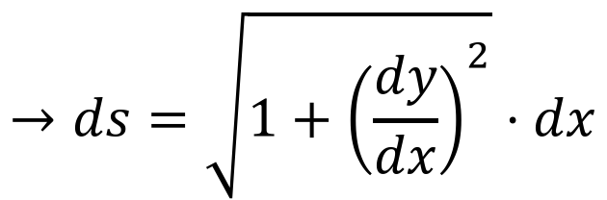
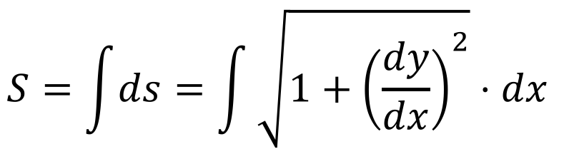

Arc Length
The length of each short section is given by
So the whole length is
$$=\sqrt{1+{\left(\frac{Δy}{Δx}\right)}^{2}}⋅Δx$$
$$→ds=\sqrt{1+{\left(\frac{dy}{dx}\right)}^{2}}⋅dx$$
$$Δs=\sqrt{{\left(Δx\right)}^{2}+{\left(Δy\right)}^{2}}$$
$$S=\int{ds}=\int{\sqrt{1+{\left(\frac{dy}{dx}\right)}^{2}}⋅dx }$$

Slide 6
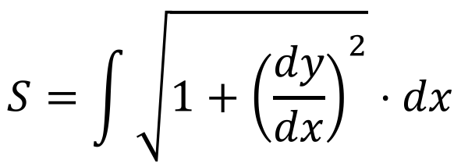




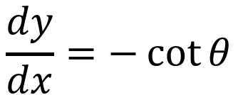
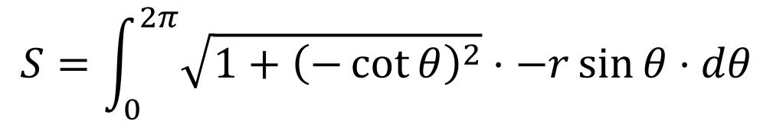
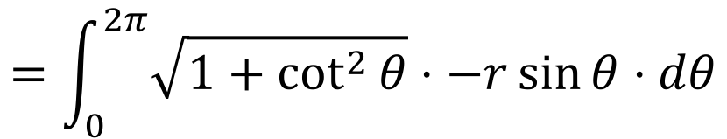
Example
Prove the circumference of a circle is $2πr$.
$$S=\int{\sqrt{1+{\left(\frac{dy}{dx}\right)}^{2}}⋅dx}$$
$$x=r\cos{θ}$$
$$dx=−r\sin{θ}⋅dθ$$
$$y=r\sin{θ}$$
$$dy=r\cos{θ}⋅dθ$$
$$\frac{dy}{dx}=−\cot{θ}$$
$$S=\int_{0}^{2π}{\sqrt{1+{\left(−\cot{θ}\right)}^{2}}⋅−r\sin{θ}⋅dθ}$$
$$=\int_{0}^{2π}{\sqrt{1+\cot^{2}{θ}}⋅−r\sin{θ}⋅dθ}$$

Slide 7
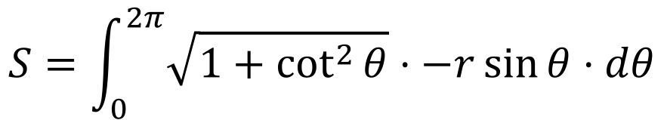
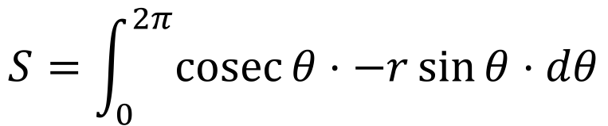
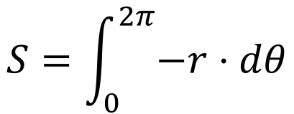
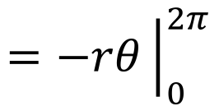



Example
The arc length method actually works clockwise, but we went anticlockwise so got a negative number instead
Prove the circumference of a circle is $2πr$.
$$S=\int_{0}^{2π}{\sqrt{1+\cot^{2}{θ}}⋅−r\sin{θ}⋅dθ}$$
$$S=\int_{0}^{2π}{\operatorname{cosec}{θ}⋅−r\sin{θ}⋅dθ}$$
$$S=\int_{0}^{2π}{−r⋅dθ}$$
$$=−rθ{\left.​\right|}_{0}^{2π}$$
$$=−r⋅2π+0$$
$$=−2πr$$
$$≈2πr$$

Slide 8
Surface of Revolution
This is almost the same thing as arc length, but with a small tweak!
If we consider a revolved object as a collection of discs, we can work out the surface area.

Slide 9
Surface of Revolution

Slide 10

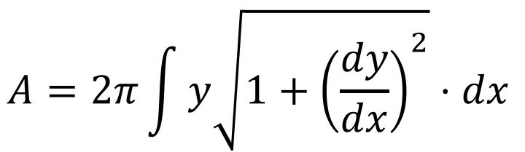
Surface of Revolution
The edge of each disc is given by $2πrh$, and we can define $h$ as we before defined $s$. $r$ is the radius $y$.
$$A=2π\int{y\sqrt{1+{\left(\frac{dy}{dx}\right)}^{2}}⋅dx }$$

Slide 11
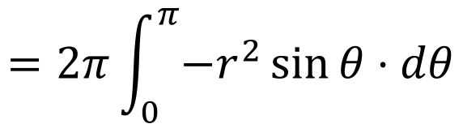


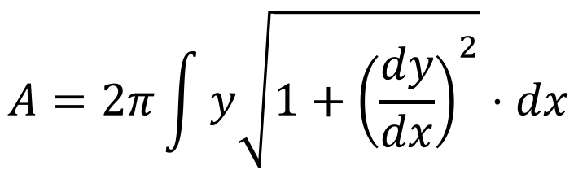

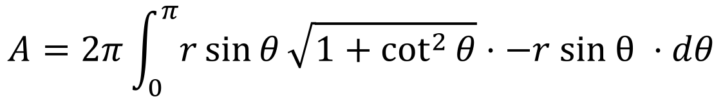
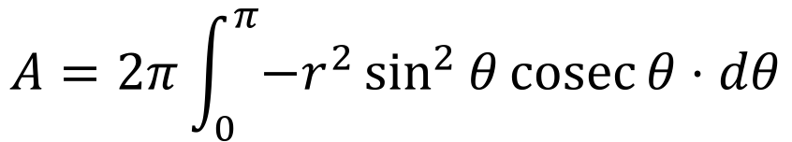
Example
Show that the surface area of a sphere is $4πr^{2}$.
$$A=2π\int{y\sqrt{1+{\left(\frac{dy}{dx}\right)}^{2}}⋅dx }$$
$$x=r\cos{θ}$$
$$dx=−r\sin{θ}⋅dθ$$
$$y=r\sin{θ}$$
$$dy=r\cos{θ}⋅dθ$$
$$\frac{dy}{dx}=−\cot{θ}$$
$$A=2π\int_{0}^{π}{r\sin{θ}\sqrt{1+\cot^{2}{θ}}⋅−r \text{sin} θ ⋅dθ}$$
$$A=2π\int_{0}^{π}{−r^{2}\sin^{2}{θ}\text{cosec}{θ}⋅dθ}$$
$$=2π\int_{0}^{π}{{−r}^{2}\sin{θ}⋅dθ}$$
$$=2π{\left[r^{2}\cos{θ}\right]}_{0}^{π}$$

Slide 12




Example
As before, we went backwards around the curve, so we can just take the positive version.
Show that the surface area of a sphere is $4πr^{2}$.
$$A=2π{\left[r^{2}\cos{θ}\right]}_{0}^{π}$$
$$A=2π\left[\left(r^{2}\cos{π}\right)−\left(r^{2}\cos{0}\right)\right]$$
$$A=2π\left[−r^{2}−r^{2}\right]$$
$$A=−4πr^{2}$$
$$A=4πr^{2}$$

Slide 13


Volume of Revolution
Again, this is basically the same thing, but easier. Now, instead of considering the edges of some disks, we’re considering the area that the disks took up. The area of a single disk is $πr^{2}$, so the entire volume is
$$V=π\int{y^{2}⋅dx }$$

Slide 14


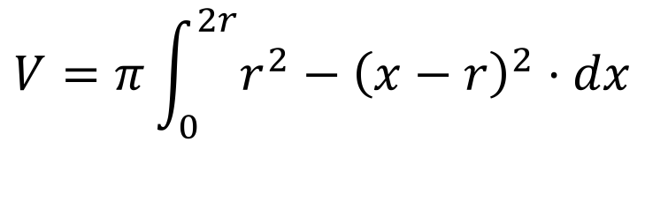
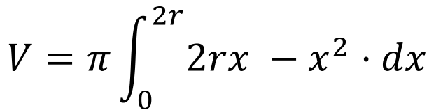

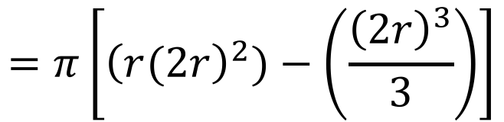


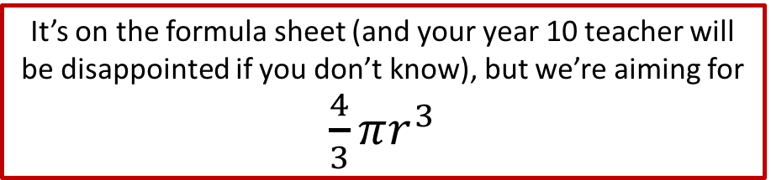
Example
It’s on the formula sheet (and your year 10 teacher will be disappointed if you don’t know), but we’re aiming for $\frac{4}{3}πr^{3}$
What is the volume of a sphere?
$$V =π{\left[rx^{2}−\frac{x^{3}}{3}\right]}_{0}^{2r}$$
$$V=π\int{y^{2}⋅dx }$$
$$=π\left[{\left(r(2r\right)}^{2})−\left(\frac{{\left(2r\right)}^{3}}{3}\right)\right]$$
$$y^{2}=r^{2}−{\left(x−r\right)}^{2}$$
$$V=π\int_{0}^{2r}{r^{2}−{\left(x−r\right)}^{2}⋅dx}$$
$$=π\left[\frac{12r^{3}−8r^{3}}{3}\right]$$
$$V=π\int_{0}^{2r}{2rx −x^{2}⋅dx}$$
$$=\frac{4}{3}πr^{3}$$

Slide 15
Do Now
Any Questions?
Delta Workbook
Exercises 21.1, 21.2, 21.3
Workbook
Pages 164-167, 170-173, 176-179

Slide 16

This work is licensed under a Creative Commons Attribution-NonCommercial-ShareAlike 4.0 International License.
Aaron Stockdill
2016

